Slide 1
Safe+Sound Iowa
Anonymous School Threat Reporting. Any Hour. Any Day.

Slide 2
Agenda
An overview of Safe+Sound Iowa
Why it’s important to make a report
How to make a report
The lifecycle of a report
Where to learn more
Find additional information at SafeandSoundIowa.gov | 2
Notes:
The purpose of this presentation is to introduce the Safe+Sound Iowa school safety reporting system and share easy-to-follow information about why, when and how to use it in helping protect against violence in Iowa’s schools.

Slide 3
Safe+Sound Iowa
Free anonymous K–12 school safety reporting system
Helps students, teachers, parents and community members keep Iowa schools safe
Helps identify and provide intervention for students in crisis before they harm themselves or others
Find additional information at SafeandSoundIowa.gov | 3
Notes:
What is Safe+Sound Iowa?
It’s a free anonymous safety reporting system available to all K-12 schools in Iowa.
Safe+Sound Iowa was developed by the Iowa Governor’s School Safety Bureau to provide students, teachers, parents and other community members a way to help identify and provide intervention for students in crisis before they harm themselves or others.

Slide 4
Safe+Sound Iowa
Helps prevent:
School violence
Unlawful possession of weapons
Self-harm
Other forms of victimization and threatening behavior
Helps enable:
School administrators and law enforcement to work together for effective interventions
Find additional information at SafeandSoundIowa.gov | 4
Notes:
The intent of Safe+Sound Iowa is to help prevent school violence, unlawful possession of weapons, self-harm and other forms of victimization and threatening behavior.
The free anonymous school safety reporting system relays information between those who report safety concerns and local teams that include schools, law enforcement agencies, and sometimes mental health resources, helping them work together to respond to students in crisis.
Safe+Sound Iowa allows communities to act, not react, to the critical issue of school safety.

Slide 5
Why Reporting Matters
In 80% of shootings, at least one other person had advance knowledge of what was to occur.
Of those who noticed concerning behavior in advance of an active shooting by a student:
92% were schoolmates.
75% were teachers or school staff.
(U.S. Secret Service and U.S. Department of Education)
(U.S. Federal Bureau of Investigation)
Find additional information at SafeandSoundIowa.gov | 5
Notes:
We know that in most acts of violence, at least one person has advance knowledge of what is to occur or notices concerning behavior ahead of time.
And when it comes to students, schoolmates often know about health or safety issues or concerns among their peers before adults do. Left unshared, the student in crisis may not receive the help or support necessary before they harm themselves or others.
Safe+Sound Iowa provides free, secure and anonymous tools to report these safety concerns so they can be shared immediately and responded to appropriately to avoid tragedy.
Sources:
“The Final Report and Findings of the Safe School Initiative,” United States Secret Service and United States Department of Education, 2004
“A Study of Pre-Attack Behaviors of Active Shooters in the U.S. Between 2000 and 2013,” U.S. Federal Bureau of Investigation

Slide 6
Ways to Make a Report
SafeandSoundIowa.gov
Select “Make a Report”
Mobile App
Tip Line
800-224-6018
w
Free. Secure. Anonymous.
Find additional information at SafeandSoundIowa.gov | 6
Notes:
School safety concerns can be reported securely and anonymously using any of the Safe+Sound Iowa tools:
1. Online at SafeandSoundIowa.gov (“Make a Report”)
2. Through the Safe+Sound Iowa mobile app, or
3. By phone at 800-224-6018.
The Safe+Sound Iowa mobile app is available to download for free from the App Store and Google Play.

Slide 7
Connecting Concerns, Creating Action
Free anonymous school safety reporting system:
Safety concerns of students, teachers, parents and community members
Safe+Sound Iowa
Local school contacts, law enforcement and/or other community partners
Outreach and support to student in crisis
Find additional information at SafeandSoundIowa.gov | 7
Notes:
Safe+Sound Iowa acts as the liaison for those reporting a safety concern and local school administration, law enforcement and other community partners, so the right steps by the right people can be taken to prevent a tragedy.
Safe+Sound Iowa provides an efficient, effective and holistic approach for quickly engaging school administrators, law enforcement and other community resources so they can work together to respond to students in crisis and provide support.

Slide 8
Safe+Sound Iowa:
Offers Early Intervention
Identify and help a student who is struggling before they cause harm to
themselves or others
Empowers Students
Advocate for your school and community by speaking out for others to play a role in keeping everyone safe
Strengthens Community
Support communities in working together to prevent and protect against acts of violence
Find additional information at SafeandSoundIowa.gov | 8

Slide 9
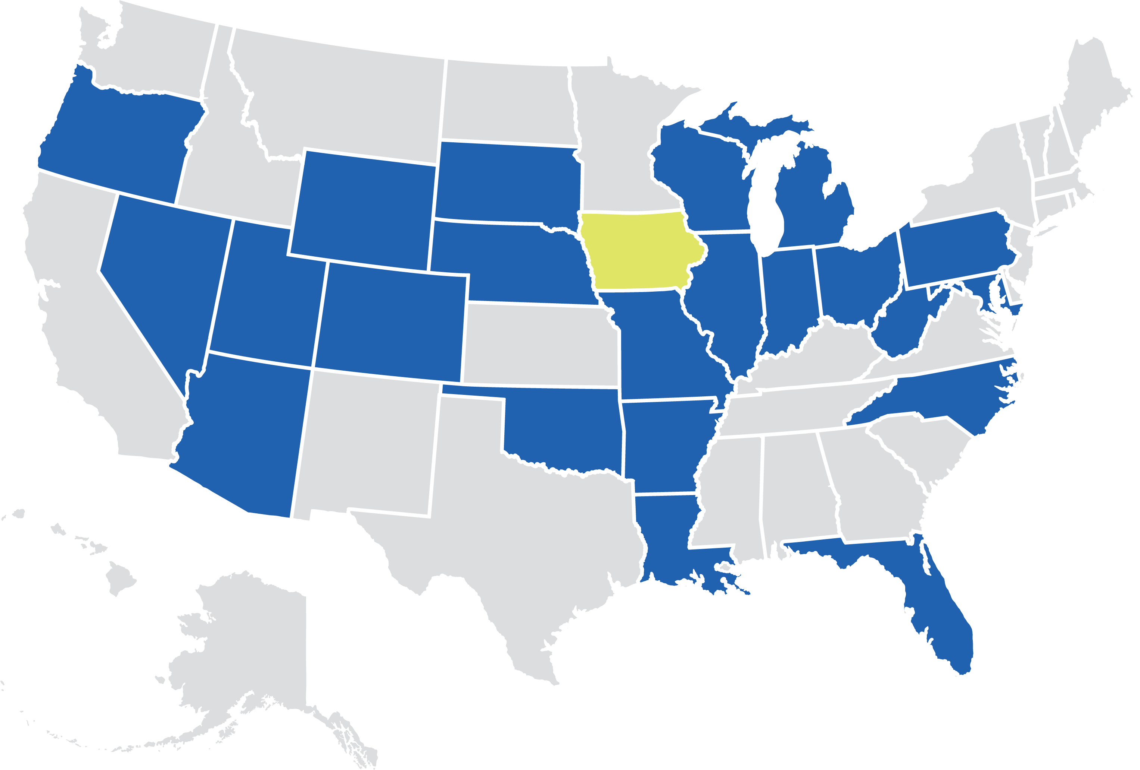
Joining A Proven Model
Iowa joins a growing list of states that are making school safety programs a priority, including: Arizona, Arkansas, Colorado, Florida, Illinois, Indiana, Louisiana, Maryland, Michigan, Missouri, Nebraska, Nevada, North Carolina, Ohio, Oklahoma, Oregon, Pennsylvania, South Dakota, Utah, West Virginia, Wisconsin and Wyoming.
Find additional information at SafeandSoundIowa.gov | 9
Notes:
The Safe+Sound Iowa school safety reporting system is based on similar programs that have been successful in engaging students, preventing tragedy and saving lives in schools across the country.

Slide 10
Step-by-Step: How to Make a Report
10

Slide 11
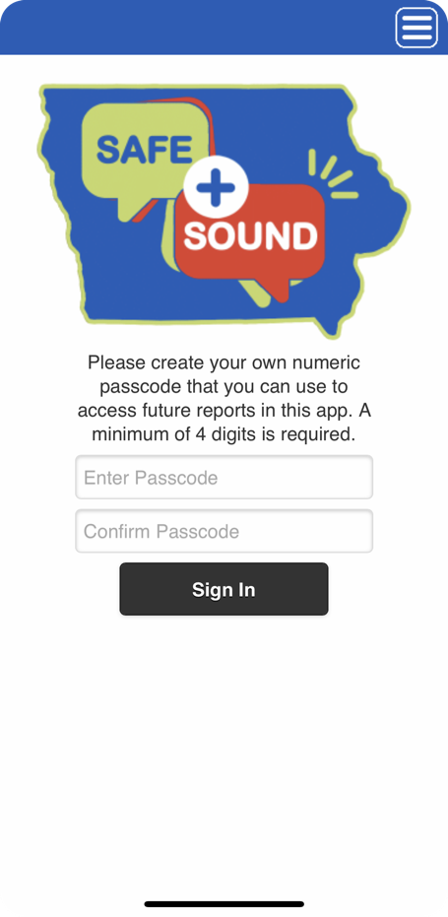
How to Make a Report
1
When using Safe+Sound Iowa for the first time to report a concern, you will be asked to enter a 4-digit passcode. You will use this passcode to log in and access your reports going forward.
1
Reports are anonymous.
Find additional information at SafeandSoundIowa.gov | 11
Notes:
1. When entering a report for the first time from the SafeandSoundIowa.gov website or the Safe+Sound Iowa mobile app, you will be asked to enter a 4-digit passcode. You will use this passcode to log in and to access your reports going forward.

Slide 12
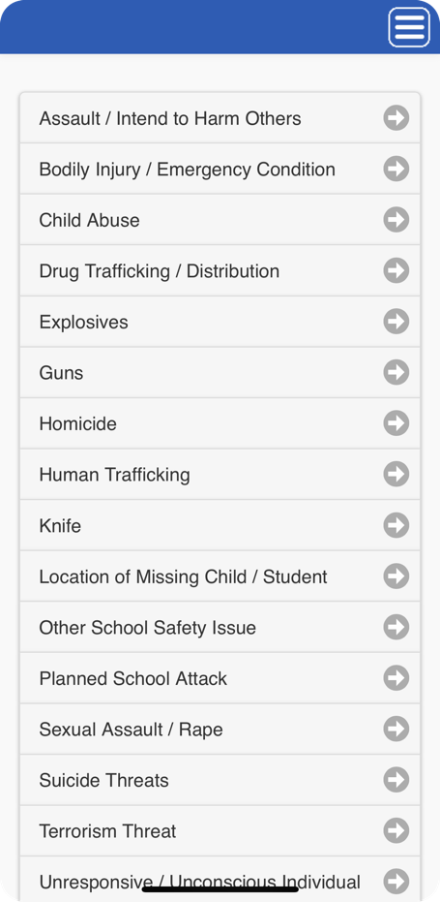
How to Make a Report
3
2
2
Select your city and school.
3
Select the type of safety concern you are reporting.
Reports are anonymous.
Find additional information at SafeandSoundIowa.gov | 12
Notes:
2. Select your city and school from the dropdown menu.
3. Select the type of safety concern or event you are reporting from the dropdown menu. You will only be allowed to choose one.

Slide 13
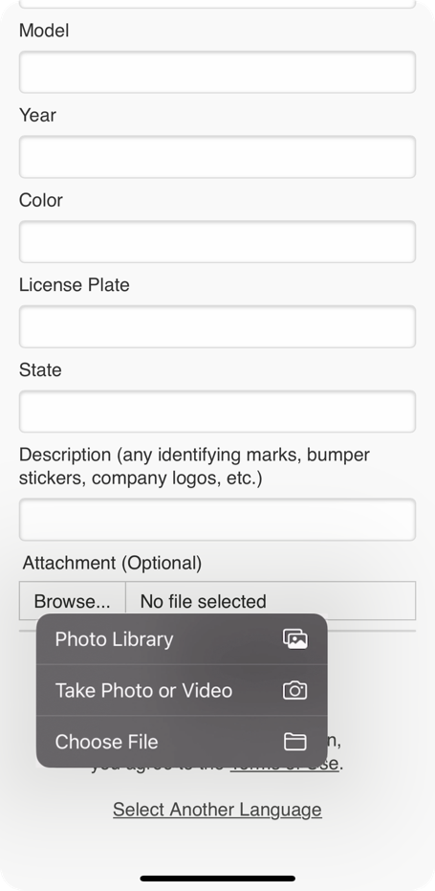
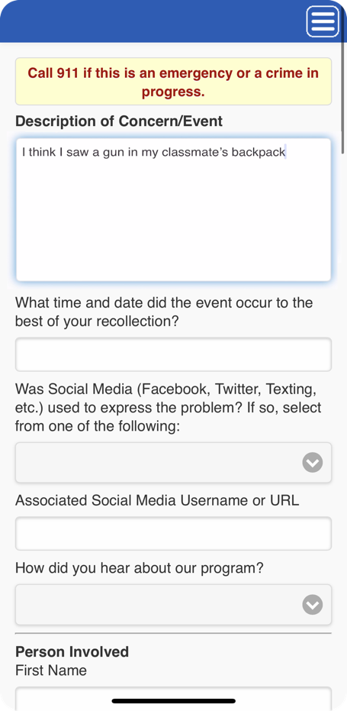
How to Make a Report
4
4
Describe your concern with as many details as possible.
Attach photos, videos, audio files, etc.
Reports are anonymous.
Find additional information at SafeandSoundIowa.gov | 13
Notes:
4. Provide a description of your concern and as many details as possible, such as:
Time and date the event occurred
Name, grade, ethnicity, gender, physical characteristics and address of the person involved
Vehicle information—make, model, year, color, license plate number and any identifying marks, bumper stickers, company logos, etc.
With your report, you can attach related photos, videos, audio files, etc.
The more information you share, the more effective the response can be to your report.
The content of your report is confidential, and any identifiable information about you remains anonymous.

Slide 14
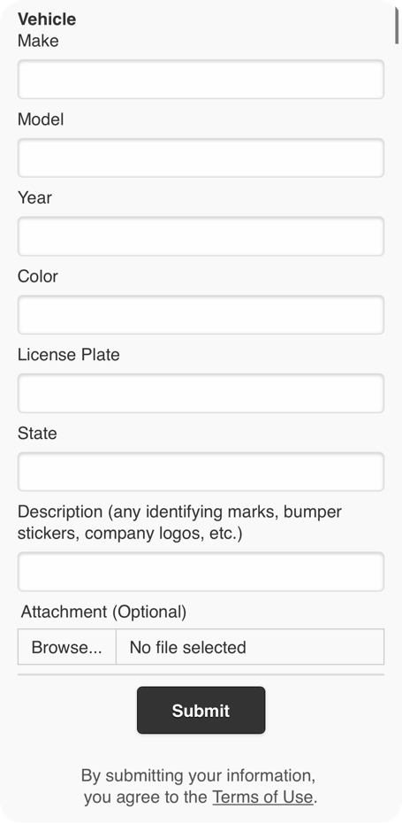
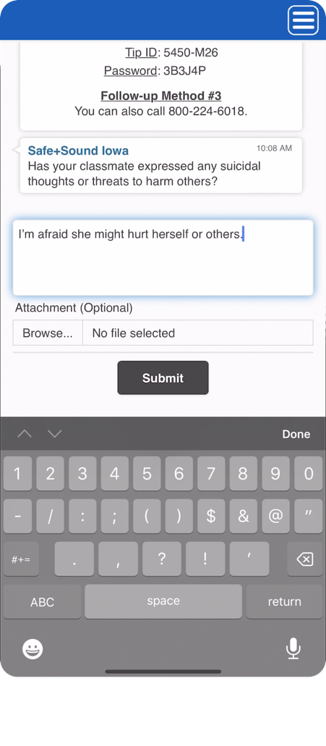
How to Make a Report
6
5
Click “Submit.” A Safe+Sound Iowa dispatcher will start a live chat session. Please stay on the line, on the app chat or on the website page for a dispatcher’s follow-up questions.
6
5
Reports are anonymous.
Find additional information at SafeandSoundIowa.gov | 14
Notes:
5. After entering your report, click “Submit.”
6. Once you have submitted your report a Safe+Sound Iowa dispatcher will start a live chat session to answer your questions and ask for additional information, if needed.
You will receive a confirmation within the chat when your report has been successfully submitted.

Slide 15
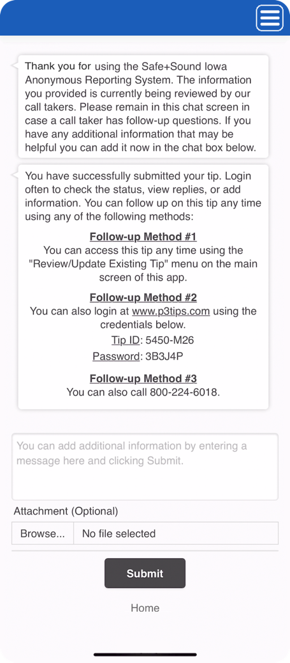
Following Up on a Report
7
7
Instructions will be given about how to follow up on the status of your report, view replies or add information later.
Please stay in the chat for a moment for possible dispatcher follow-up questions.
Reports are anonymous.
Find additional information at SafeandSoundIowa.gov | 15
Notes:
7. Instructions will be given about how to follow-up on the status of your report, view replies from Safe+Sound Iowa or add information.
Safe+Sound Iowa mobile app – Use the “Review/Update Existing Tip” menu on the main screen
SafeandSoundIowa.gov – Use the unique ID and password provided at the time you submitted your report
Safe+Sound Iowa tip line – Call 800-224-6018 and share your request with the dispatcher

Slide 16
How to Make a Report Frequently Asked Questions
When I make a report, how does Safe+Sound Iowa protect my anonymity? Safe+Sound Iowa will only ask for details about the situation causing concern. You will not be asked to provide your name, contact information or any other identifying information when making a report. How much information do I need to know about a situation before I make a report? If you have a safety concern about a student at risk for harming themselves or others, you should make a report as soon as possible with the information you have.
When a report is made about a student, how is the student’s information protected? Safe+Sound Iowa reporting information is kept confidential and is not subject to disclosure under Iowa open records laws. Threat report information is only shared with designated school staff and law enforcement with a right and need to know to address reported concerns.
Find additional information at SafeandSoundIowa.gov | 16

Slide 17
Safe+Sound Iowa: Lifecycle of a Report
17

Slide 18
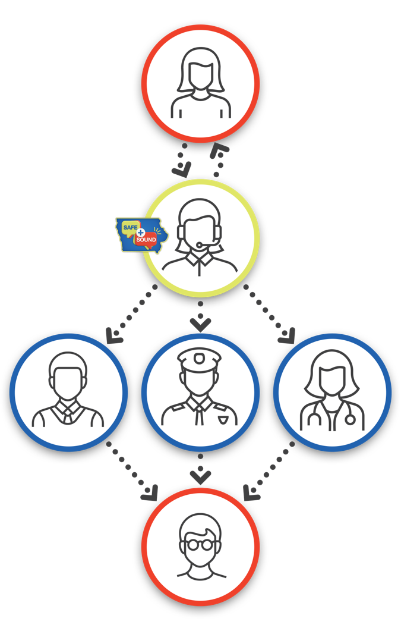
Lifecycle of a Report
A safety concern is reported securely and anonymously via:
SafeandSoundIowa.gov
Safe+Sound Iowa mobile app
800-224-6018
Reports are monitored 24/7, 365 days a year.
Find additional information at SafeandSoundIowa.gov | 18
Notes:
A safety concern is reported securely and anonymously via:
SafeandSoundIowa.gov
Safe+Sound Iowa mobile app, or
800-224-6018
Reports are monitored 24/7, 365 days a year.

Slide 19
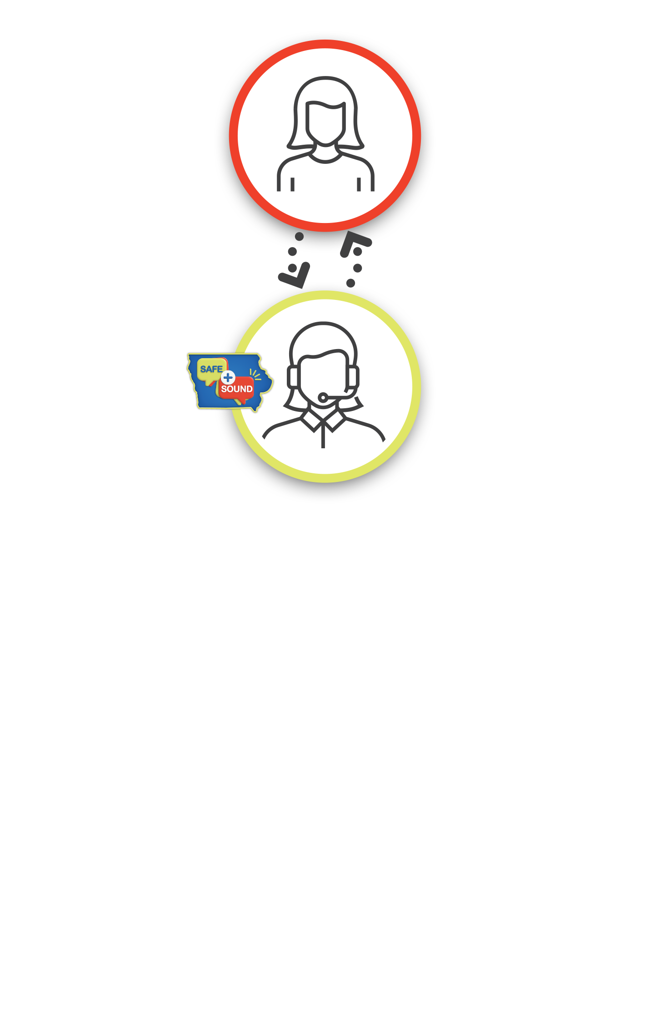
Lifecycle of a Report
A trained Safe+Sound Iowa dispatcher receives the report and opens a live two-way chat to answer questions and ask for additional information, if necessary.
Find additional information at SafeandSoundIowa.gov | 19
Notes:
A trained Safe+Sound Iowa dispatcher receives the report and opens a live two-way dialog to answer questions and ask for additional information, if necessary.

Slide 20
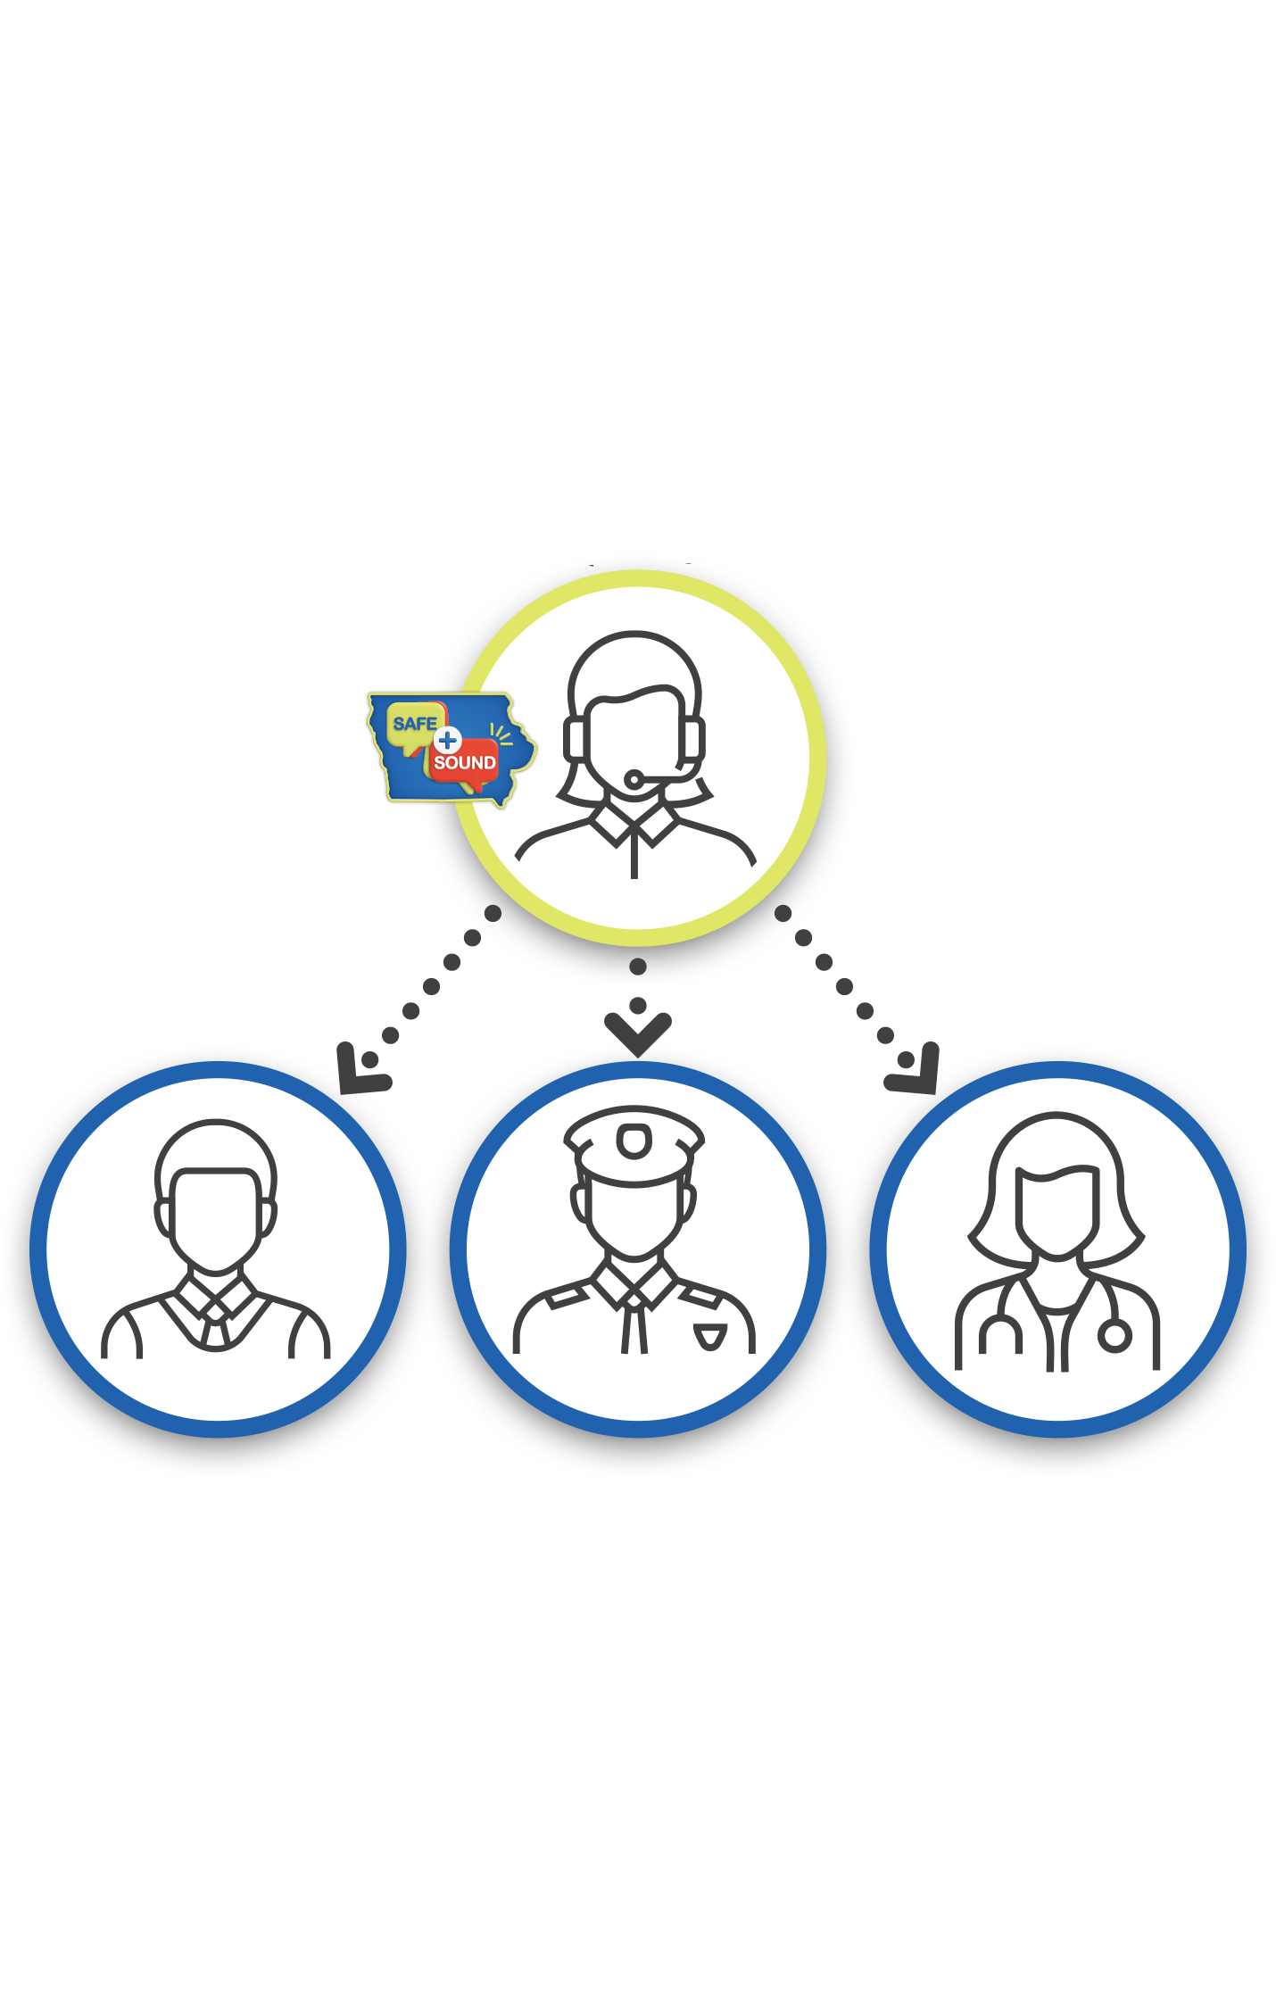
Lifecycle of a Report
The report is immediately vetted and sent to the designated local school administrator, law enforcement official and/or other community partners.
Content will determine who will respond to the report and how the situation will be addressed.
Find additional information at SafeandSoundIowa.gov | 20
Notes:
The report is immediately vetted and sent to the designated local contacts for the associated school and/or law enforcement.
Content within the report determines who will respond and how the situation will be addressed.

Slide 21
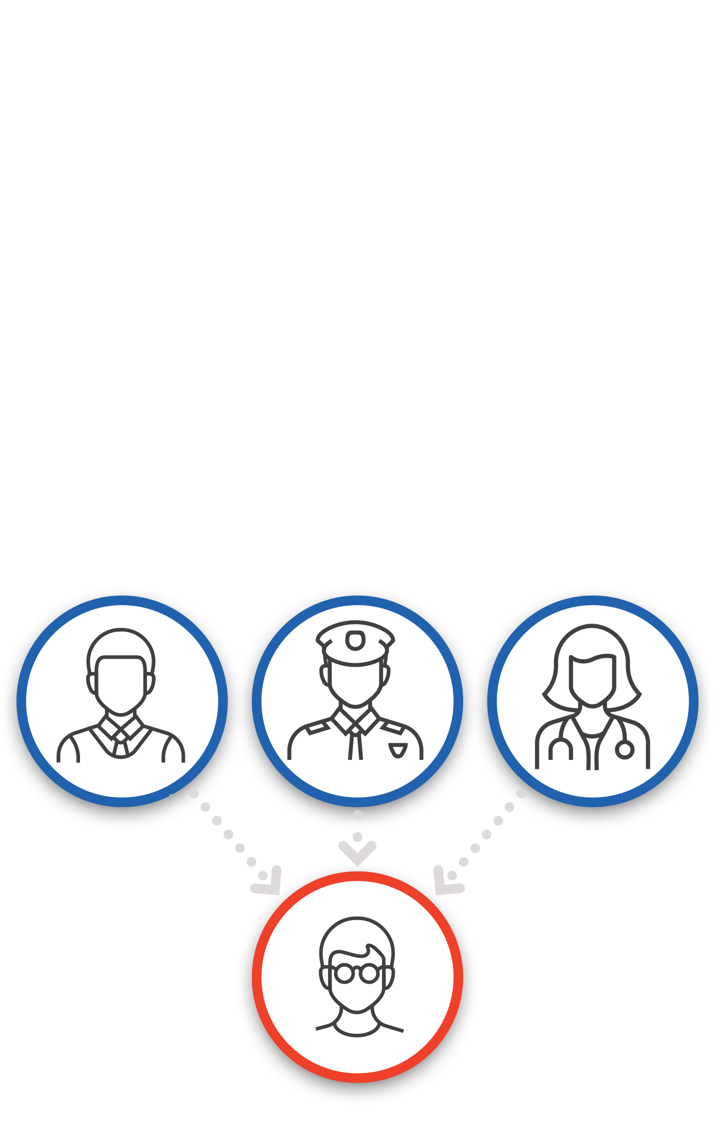
Lifecycle of a Report
The student in crisis or at risk receives the help they need BEFORE they ever get to the point of harming themselves or others.
The report is closed by the responding local school or law enforcement official.
Find additional information at SafeandSoundIowa.gov | 21
Notes:
The student in crisis or at-risk receives the help they need BEFORE they ever get to the point of harming themselves or others.

Slide 22
Lifecycle of a Report Frequently Asked Questions
Am I able to find out how my reported safety concern was resolved? No. Because reports are anonymous and all information is confidential, you will not be informed of how a situation was resolved.
How does Safe+Sound Iowa determine which school and/or law enforcement official to contact when a report is made? Your community’s school administrators and local law enforcement partners have identified and shared the contacts to be included as part of the Safe+Sound Iowa school safety reporting system.
Find additional information at SafeandSoundIowa.gov | 22

Slide 23
False Reporting
Safe+Sound Iowa is intended to be a school violence prevention program to save lives. The website, mobile app and tip line should be used responsibly to report school safety concerns.
Like misusing 911 or filing a false police report, knowingly submitting a false report to Safe+Sound Iowa could have serious consequences, including being charged with a crime.
Find additional information at SafeandSoundIowa.gov | 23

Slide 24
Find more information about Safe+Sound Iowa at SafeandSoundIowa.gov.
Questions?
Email the Safe+Sound Iowa team: safeandsoundiowa@dps.state.ia.us.
Safe+Sound Iowa is a program of the Governor’s School Safety Bureau

